Slide 1
LungScanAI: AI-Powered Lung Health Diagnostics
NextGen Diagnostics
Ume-Salma | 360
Abdul Qayyum | 330
Muawaz Saleem | 356

Slide 2
LungScanAI: AI-Powered Lung Health Diagnostics
Unit 1. Introduction
1.1. Project Overview
1.2. Problem Statement
1.3. Objectives
Unit 2. Methodology
2.1. Data Acquisition
2.2. Data Preprocessing
2.3. Model Architecture
2.4. Training and Validation
Unit 3. Results, Discussion and Future work
3.1. Model Performance
3.2. Discussion and Implications
3.3. Future Directions

Slide 3
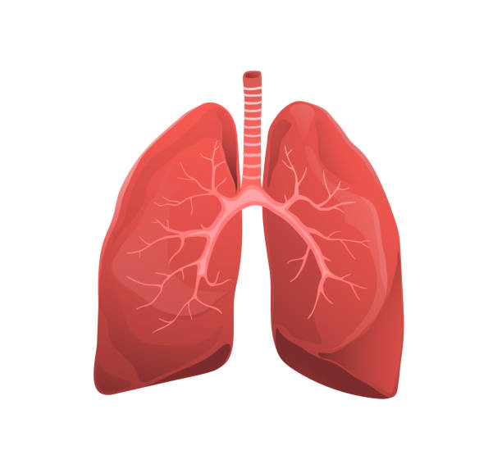
Introduction to
the Project
LungScan AI, powered by the EfficientNet B0 model, is an advanced diagnostic tool that utilizes deep learning to accurately detect lung diseases from Chest-Xray images. This AI-driven system helps healthcare professionals diagnose conditions like tuberculosis (TB), COVID-19, pneumonia, and lung cancer with high precision, ensuring early detection and better treatment outcomes for patients.

Slide 4
LungScanAI: AI-Powered Lung Health Diagnostics
Introduction
1. Overview of LungScanAI
LungScanAI is an AI-powered diagnostic tool focused on lung health.
It detects diseases like TB, lung cancer, and pneumonia.
2. Importance of the Project
Rising cases of lung diseases globally require better diagnostics.
Current diagnostic methods are time-consuming and require expertise.
3. Objectives
Enhance diagnostic accuracy and speed.
Improve accessibility for underserved regions.

Slide 5
LungScanAI: AI-Powered Lung Health Diagnostics
Methodology
2.1. Data Acquisition
Use of publicly available datasets like Kaggle Chest X-rays.
Included diverse conditions to enhance model performance.
2.2. Data Preprocessing
Image normalization and augmentation techniques.
Improved data quality and ensured model robustness.
2.3. Model Architecture
CNN-based deep learning model for image analysis.
Custom layers optimized for lung disease classification.
2.4. Training and Validation
Split data into training and validation sets.
Achieved an accuracy of 95% using EfficientNet B0.

Slide 6
LungScanAI: AI-Powered Lung Health Diagnostics
Results, Discussion, and Future Work
3.1. Model Performance
Achieved 95% accuracy.
Compared results with existing diagnostic tools.
3.2. Discussion and Implications
Highlighted the impact of LungScanAI in healthcare.
Discussed challenges like data biases and computational costs.
3.3. Future Directions
Expanding to additional lung diseases.
Integration with real-time diagnostic devices and cloud services.

Slide 7
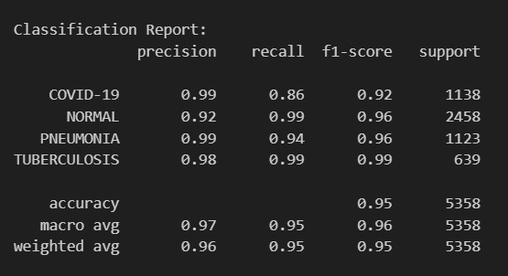

Slide 8
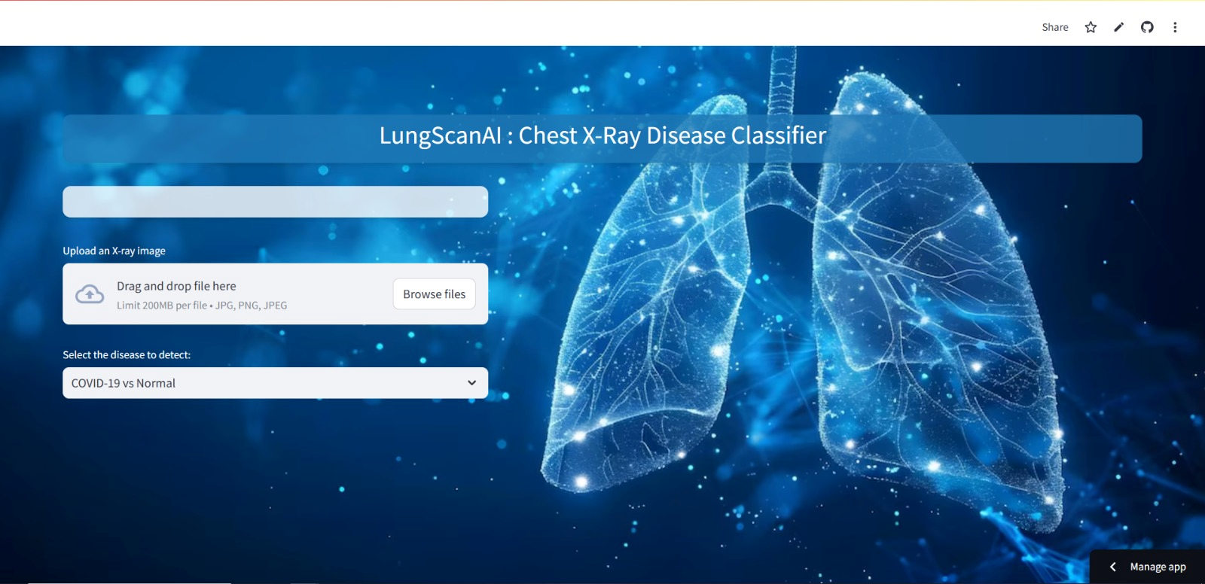

Slide 9
Resources
Streamlit
App1 [TB,P,C]
App2 [Lung Cancer]
Dataset
Dataset

Slide 10
Thanks
Any Questions?

